Slide 1
Unit-9 Dimensional Modeling

Slide 2
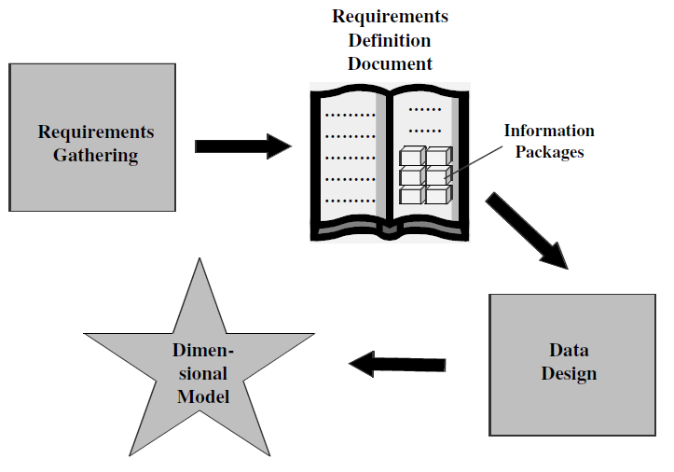
Requirements to Design

Slide 3
Design decisions to be taken
Choosing the process:-deciding subjects
Choosing the grain
Identifying and confirming dimensions
Choosing the facts
Choosing the duration of the database

Slide 4
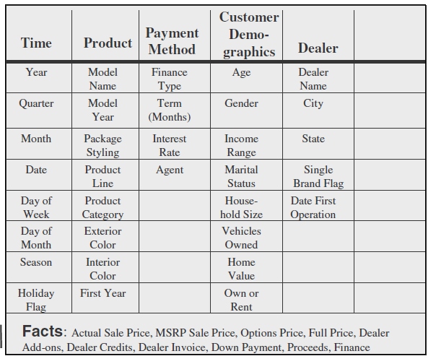
Dimensional modeling basics

Slide 5
Formation of the automaker sales fact table

Slide 6
Formation of the automaker dimension tables
How much sales proceeds did the jeep tata mahindra, 2005 model with vxi options, generate in january 2000 at spectra auto dealership for buyers who owned their homes, financed by icici prudential financing?

Slide 7
ER Model v/s Dimension Model
ER diagram is a complex diagram, used to represent multiple processes. A single ER diagram can be broken down into several DM diagrams.
In DM, we prefer keeping the tables de-normalized, whereas in a ER diagram, our main aim is to remove redundancy
ER model is designed to express microscopic relationships between elements. DM captures the business measures
DM is designed to answer queries on business process, whereas the ER model is designed to record the business processes via their transactions.

Slide 8
Entity-Relationship vs. Dimensional Models
E-R DIAGRAM
One table per entity
Minimize data redundancy
Optimize update
The Transaction Processing Model
DIMENSIONAL MODEL
One fact table for data organization
Maximize understandability
Optimized for retrieval
The data warehousing model

Slide 9
Star Schema-example of order analysis
Query result

Slide 10
Star Schema-example of order analysis
For a given amount of dollars, what was the product sold? Who was the customer? Which salesperson brought the order? When was the order placed?
When a query is made against the data warehouse, the results of the query are produced by combining or joining one of more dimension tables with the fact table.
The joins are between the fact table and individual dimension tables.
The relationship of a particular row in the fact table is with the rows in each dimension table.

Slide 11
Star Schema-example of order analysis
Take a simple query against the STAR schema. Let us say that the marketing department wants the quantity sold and order dollars for product bigpart-1, relating to customers in the state of Maine, obtained by salesperson Jane Doe, during the month of June.
Figure shows how this query is formulated from the STAR schema.

Slide 12
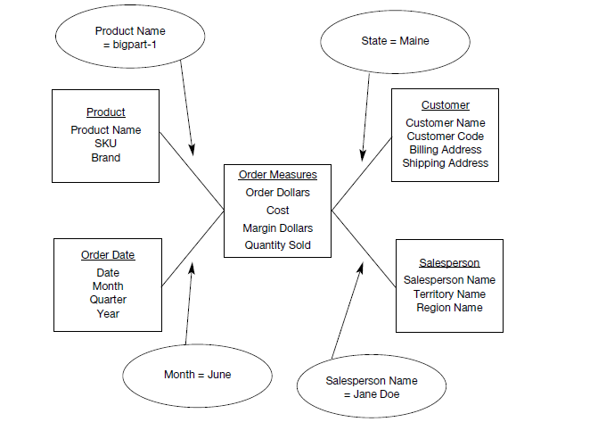
Understanding query from the star schema

Slide 13
Drill down analysis from the star schema
A common type of analysis is the drilling down of summary numbers to get at the details at the lower levels.
Let us say that the marketing department has initiated a specific analysis by placing the following query:
Show me the total quantity sold of product brand big parts to customers in the Northeast Region for year 1999.
In the next step of the analysis, the marketing department now wants to drill down to the level of quarters in 1999 for the Northeast Region for the same product brand, big parts.
Next, the analysis goes down to the level of individual products in that brand. Finally, the analysis goes to the level of details by individual states in the Northeast Region.

Slide 14
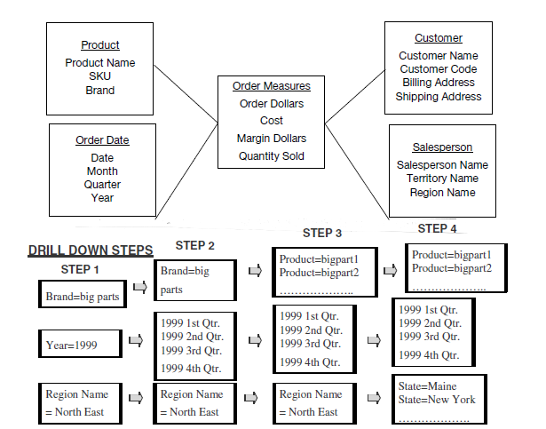
Understanding drill down analysis from the star schema

Slide 15
Dimension table
Contain information about a particular dimension.
Dimension table key
Table is wide
Textual attributes
Attributes not directly related
Not normalized
Drilling down, rolling up
Multiple hierarchies
Fewer number of records

Slide 16
Facts
Numeric measurements (values) that represent a specific business aspect or activity
Stored in a fact table at the center of the star scheme
Contains facts that are linked through their dimensions
Can be computed or derived at run time

Slide 17
Fact table
Contains primary information of the warehouse
Concatenated key
Data grain: level of details for the measurements.
Fully additive measures
Semi-additive measures(derived attributes)
Table deep, not wide
Sparse data:(The fact table rows for closed dates will not have values for the measures(null)).
Degenerate dimensions(attributes which are neither fact or a dimension)

Slide 18
Fact table
Measures :
Additive: Additive facts are facts that can be summed up through all of the dimensions in the fact table.
Semi-Additive: Semi-additive facts are facts that can be summed up for some of the dimensions in the fact table, but not the others.
Table deep, not wide:
Take a very simplistic example of 3 products, 5 customers, 30 days, and 10 sales representatives represented as rows in the dimension tables. Even in this example, the number of fact table rows will be 4500, very large in comparison with the dimension table rows.

Slide 19
Fact table - Example
*Each of these relates to a particular product on a certain date for a specific customer procured.
Order_Date_Key
Customer_Key
Product_Key
*Unit Sold *Sales_Amount *Cost_ Amount Profit_margin *Order_Number
*When you pick up attributes for the dimension tables and the fact tables from operational systems, you will be left with some data elements in the operational systems that are neither facts nor strictly dimension attributes. These attributes are useful in some types of analyses. For example, you may be looking for average number of products per order. Then you will have to relate the products to the order number to calculate the average.
Notes:
In each order number number of products will be there. Products sold per order in a day or over all average products per order there u will need the unique order number

Slide 20
Fact table-Example
Suppose that a company sells products to customers.
Every sale is a fact that happens. The purpose of this table is to record the units sold of each product to each customer on a daily basis.
Unit Sold is an additive fact, because you can sum up this fact along any of the three dimensions present in the fact table -- time, customer, and product. For example, the sum of Unit Sold for all 7 days in a week represents the total units sold for that week.
Order_Date_Key | Product_Key | Customer_Key | Unit Sold
4 | 17 | 2 | 1
8 | 21 | 3 | 2
8 | 4 | 1 | 1
3 | 4 | 2 | 5

Slide 21
Dimension table-Example
Dimension table about customers:
Customer ID | Name | Gender | Income | Education | Region
1 | Brian Edge | M | 2 | G | 4
2 | Fred Smith | M | 3 | D | 1
3 | Sally Jones | F | 1 | G | 3
4 | Tom | F | 6 | PG | 2

Slide 22
Dimension table-Example
Dimension table about products:
Product ID | Product Name | Brand
4 | Product_A | Samsung
10 | Product_B | LG
17 | Product_C | Samsung
21 | Product_D | Sony

Slide 23
Dimension table-Example
Dimension table about time:
Time Id | Week | month | year
1 | 1 | 1 | 2001
2 | 1 | 1 | 2001
3 | 1 | 1 | 2001
4 | 1 | 1 | 2001
5 | 1 | 1 | 2001
6 | 1 | 1 | 2001
7 | 1 | 1 | 2001
8….30 | 2 | 1 | 2001
Notes:
Day wise week wise and month wise

Slide 24
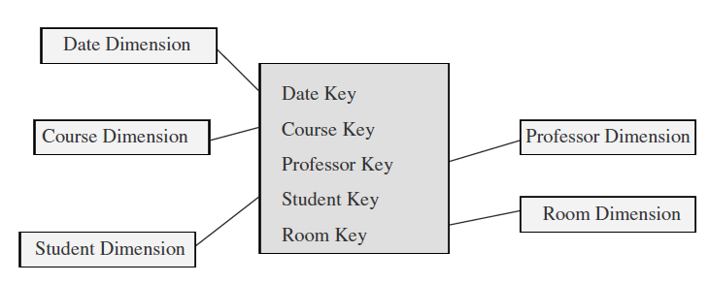
Factless fact table
A fact table is said to be empty if it has no measures to be displayed. Fact table represents events
Contains no data, only keys.

Slide 25
Factless fact table
Let us say we are building a fact table to track the attendance of students. For analyzing student attendance, the possible dimensions are student, course, date, room, and professor. The attendance may be affected by any of these dimensions. When you want to mark the attendance relating to a particular course, date, room, and professor, what is the measurement you come up for recording the event? In the fact table row, the attendance will be indicated with the number one. Every fact table row will contain the number one as attendance.
If so, why bother to record the number one in every fact table row? There is no need to do this. The very presence of a corresponding fact table row could indicate the attendance.
This type of situation arises when the fact table represents events. Such fact tables really do not need to contain facts. They are “factless” fact tables.

Slide 26
Data Granularity
If the fact table is at the lowest grain, the users can as well drill down to the lowest grain of details.
A single row in the fact table should contain measurements at the lowest level for an individual product, ordered on a specific date, relating to an individual customer, and procured by an individual sales representative.
Let us say we want to add a new attribute of district in the sales representative dimension. This change will not warrant any changes in the fact table rows.
Advantage
Easier to extract from operational data and load into DW.
Compromise on the storage and maintenance of DW.

Slide 27
Keys in the Data Warehouse Schema

Slide 28
Keys in the Data Warehouse Schema
The first principle to follow is: Avoid built-in meanings in the primary key of the dimension tables.
The second principle is: Do not use production system keys as primary keys for dimension tables.
The general practice is to keep the operational system keys as additional attributes in the dimension tables.
Notes:
Production System Key: This refers to the primary key or unique identifier used in the source system or systems where the data originates. Each record in the production system has a unique identifier that distinguishes it from other records.
Operational System Key: This is a key that is specific to the data warehouse itself, and it is used to uniquely identify records within the data warehouse environment. Once the data is loaded into the data warehouse, it may undergo transformations, aggregations, and other processes. The operational system key is typically assigned during the data loading process and is used internally within the data warehouse to efficiently manage and query the data. It may or may not be the same as the production system key, depending on the data modeling and integration requirements.

Slide 29
Keys in the Data Warehouse Schema
Primary keys: Each row in a dimension table is identified by a unique value of an attribute designated as the primary key of the dimension. In a product dimension table, the primary key identifies each product uniquely.
Surrogate keys: System generated sequence numbers having no built-in meanings. The surrogate keys will be mapped to the
production system keys.
Foreign keys: Each dimension table is in a one-to-many relationship with the central fact table. So the primary key of each dimension table must be a foreign key in the fact table.

Slide 30
Primary key for Fact table
1.A single compound primary key whose length is the total length of the keys of the individual dimension tables. Under this option, in addition to the compound primary key, the separate foreign keys must also be kept in the fact table as additional attributes. This option increases the size of the fact table.
2. Concatenated primary key that is the concatenation of all the primary keys of the dimension tables. Here you need not keep the primary keys of the dimension tables as additional attributes to serve as foreign keys. The individual parts of the primary keys themselves will serve as the foreign keys.
3. A generated primary key independent of the keys of the dimension tables. In addition to the generated primary key, the foreign keys must also be kept in the fact table as additional attributes. This option also increases the size of the fact table.
In practice, option (2) is used in most fact tables. This option enables you to easily relate the fact table rows with the dimension table rows.

Slide 31
Star Schema characteristics
Star schema is a relational model with one-to-many relationship between the fact table and the dimension tables.
De-normalized relational model
Easy to understand. Reflects how users think. This makes it easy for them to query and analyse the data.
Optimizes navigation.
Enhances query extraction.
Ability to drill down or roll up.

Slide 32
Advantages of the star schema
Easy for users to understand
Optimizes navigation
Most suitable for query processing

Slide 33
Dimensional modeling: Advanced Topics

Slide 35
Objectives
Slowly changing dimensions
Large dimensions
Snowflake schema
Aggregate tables
Family of starts and their applications

Slide 36
Updating the Dimension table
Every day as more and more sales take place, more and more rows get added to the fact table. The fact table continues to grow in the number of rows over time.
Compared to the fact table, the dimension tables are more stable and less volatile.
However, unlike the fact table, which changes through
the increase in the number of rows, a dimension table does not change just through the increase in the number of rows, but also through changes to the attributes themselves.

Slide 37
Updating the Dimension table
More rows are added to the Dimension tables over time.
Changes to certain attributes of a row become important at times.
There are many types of changes that affect the dimension tables.

Slide 38
Changing Dimensions- Examples
The product category for a product was changed.
Consider the customer dimension table. What happens when a customer’s status changes from rental home to own home? The corresponding row in that dimension table must be changed.
The payment method dimension table. When finance type changes for one of the payment methods, this change must be reflected in the payment method dimension table.

Slide 39
Slowly changing dimensions: Principles
Most dimensions are generally constant over time
Many dimensions, though not constant over time, change slowly
The product key of the source record does not change
The description and other attributes change slowly over time
In the source OLTP systems, the new values overwrite the old
ones
Overwriting of dimension table attributes is not always the
appropriate option in a data warehouse
The ways changes are made to the dimension tables depend on
the types of changes and what information must be preserved
in the data warehouse

Slide 40
Type 1: Correction of errors
The general principles for Type 1 changes:
Usually change relate to correction of errors in the source systems.
E.g., spelling error in customer names; change of names of customers;
There is no need to preserve the old values here.
The old value in the source system needs to be discarded.
The changes made need not be preserved or noted.

Slide 41
Type 1: Correction of errors
The method for applying Type 1 changes is:
Overwrite the attribute value in the dimension table row with the new value
The old value of the attribute is not preserved
No other changes are made in the dimension table row
The key of this dimension table or any other key values are not affected
This type is easiest to implement

Slide 42
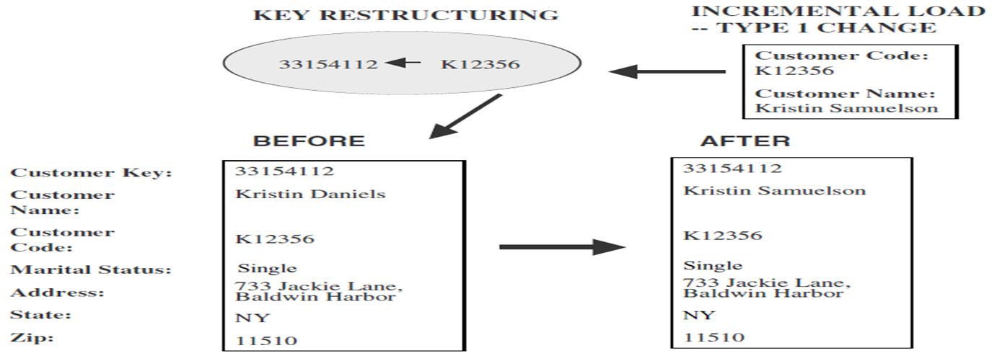
The method for applying Type 1 changes

Slide 43
Type 2: Preservation of History
The general principles for this type of change:
True changes in the source systems.
E.g., change of marital status; change of address
There is a need to preserve history
This type of change partitions the history in the data warehouse
Every change for the same attribute must be preserved.

Slide 44
The method for applying Type 2 changes
The method for applying Type 2 changes is:
Add a new dimension table row with the new value of the changed attribute
An effective date field may be included in the dimension table
There are no changes to the original row in the dimension table
The key of the original row is not affected
The new row is inserted with a new surrogate key

Slide 45
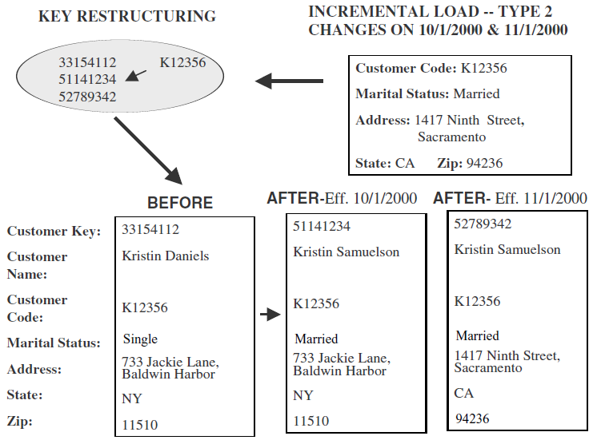
The method for applying Type 2 changes
Samuelson

Slide 46
Type 3: Tentative Soft Revision
The general principles for Type 3 changes:
Sometimes, though rarely, there is a need to track both the old and new values of changed attributes for a certain period, in both forward and backward directions. These types of changes are Type 3 changes .
Tentative changes in the source system
E.g., if an employee will get posted for a short period to a different location
There is a need to keep track of history with old and new values of the changed attribute
Used to compare performances across the transition

Slide 47
Type 3 change : Example
Assume your marketing department is planning a realignment of the territorial assignments for salespersons. Before making a permanent realignment, they want to count the orders in two ways: according to the current territorial alignment and also according to the proposed realignment. This type of provisional or tentative change is a Type 3 change.

Slide 48
The method for applying Type 3 changes
The method for applying Type 3 changes
Add an “old” field in the dimension table for the affected attribute
Push down the existing value of the attribute from the “current” field to the “old” field
Keep the new value of the attribute in the “current” field
Also, you may add a “current” effective date field for the attribute
The key of the row is not affected

Slide 49
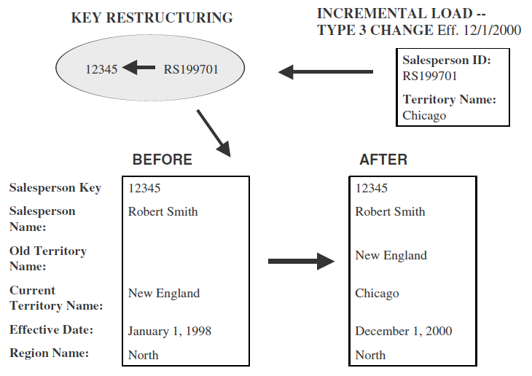
The method for applying Type 3 changes

Slide 50
miscellaneous dimensions
Large dimensions
Rapidly changing dimensions
Junk dimensions

Slide 51
Large dimensions
You may consider a dimension large based on two factors:
Very deep(large number of rows)
Very wide(large number of attributes)
Have multiple hierarchies
Large dimensions call for special considerations. Because of the sheer size, many data warehouse functions involving large dimensions could be slow and inefficient.
You need to address the following issues by using effective design methods, by choosing proper indexes,
and by applying other optimizing techniques.

Slide 52
Here are some typical features of large customer and product dimensions:
Customer
Huge—in the range of 20 million rows
Easily up to 150 dimension attributes
Can have multiple hierarchies
Product
Sometimes as many as 100,000 product variations
Can have more than 100 dimension attributes
Can have multiple hierarchies

Slide 53
We had assumed that dimension attributes do not change too rapidly. If the change is a Type 2 change, you know that you have to create another row with the new value of the attribute. If the value of the attribute changes again, then you create another row with the newer value. What if the value changes too many times or too rapidly? Such a dimension is no longer a slowly changing dimension.

Slide 54
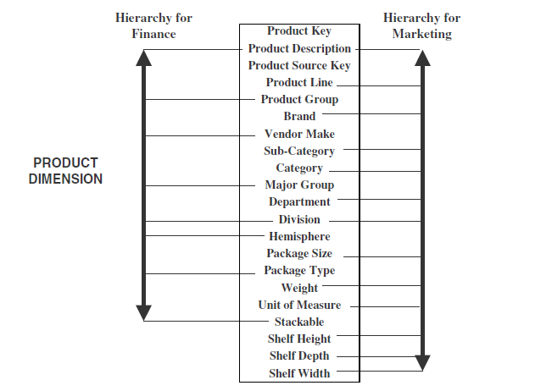
Multiple hierarchies

Slide 55
Rapidly changing dimensions

Slide 56
Snowflake schema
A variation of the star schema, in which all or some of the dimension tables may be normalized.
Eliminates redundancy
Generally used when a dimension table is wide.
Saves space
Complex querying is required.

Slide 57
Star schema for sales

Slide 58
Normalized product dimension

Slide 59
Sales snowflake schema

Slide 60
Advantages and disadvantages
Advantages
Small savings in storage space
Normalized structures are easier to update and maintain
Disadvantages
Schema is less sensitive
Browsing becomes difficult
Degraded query performance because of additional joins

Slide 61
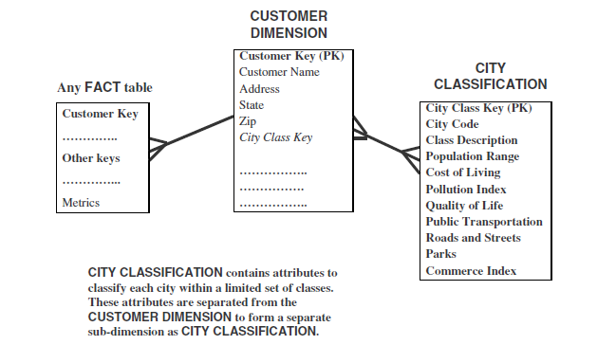
When to snowflake

Slide 62
Aggregate fact tables
Contain pre-calculated summaries derived from the most granular (detailed) fact table.
Created as a specific summarization across any number of dimensions.
Reduces runtime processing.
Notes:
weel

Slide 63
Why need aggregate fact tables?
Large size of the fact table
To speed up query extraction
Limitations
Must be re-aggregated each time there is a change in the source data
Do not support exploratory analysis
Limited interactive use.

Slide 64
Fact Constellation
Multiple fact tables share dimension tables.
This schema is viewed as collection of stars hence called galaxy schema or fact constellation.
Sophisticated application requires such schema.

Slide 65
Fact Constellation (contd..)
Sales
Fact Table
Shipping
Fact Table
Store Key
Product Key
Period Key
Units
Price
Product Dimension
Shipper Key
Store Key
Product Key
Period Key
Units
Price
Product Key
Product Desc
Store Dimension
Store Key
Store Name
City
State
Region

